Slide 1

Ramadan
Student Health & Human Services
Human Relations Diversity & Equity
June 2022

Slide 2
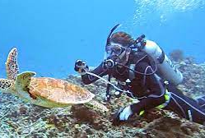
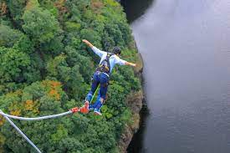
Would you rather...
Deep sea diving
Bungee jumping

Slide 3
Objectives
Learn
about the religious practice of Ramadan
Identify
the customs that are practiced.
Discuss
our own cultural/religious practices and how they are similar/ different from Ramadan.

Slide 4
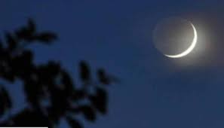
What is Ramadan?
It is observed by Muslims all over the world as a month of fasting, prayer, reflection, and community.
It is believed that it was during this time that the Quran was given to the Islamic Prophet Muhammad.
It is also regarded as one of the Five Pillars of Islam and lasts 29-30 days, from one sighting of the crescent moon to the next.

Slide 5
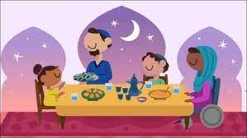
How is it celebrated?
During Ramadan, observers fast from dawn until sunset. Every day, they will have a pre-dawn meal (Suhoor) and will eat again at sunset (iftar).
There is also a morning prayer and evening prayers.
During this time of fasting, observers of Ramadan also abstain from sexual relations, as well as sinful speech and behaviors.
Muslims believe that Ramadan teaches them to practice self-discipline, self-control, sacrifice, and empathy for those less fortunate.

Slide 6
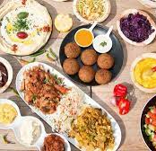
The Food
The sunset meal (iftar) includes dates to commemorate Muhammad's practice of breaking his fast with 3 dates.
Typical main dishes include lamb stewed with wheat berries, lamb kebabs with grilled vegetables, and roasted chicken served with chickpea-studded rice pilaf.
Desserts may include luqaimat, baklava or kunafeh. This is considered the most important part of the meal.

Slide 7
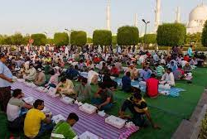
Community
Over time, the practice of iftar (sunet meal) has evolved into banquets that may accommodate hundreds or even thousands of diners.
The Sheikh Zayed Grand Mosque in Abu Dhabi, the largest mosque in the UAE, feeds up to thirty thousand people every night.

Slide 8
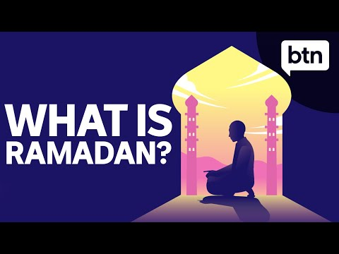
What is Ramadan?
Notes:
https://youtu.be/5pvmUoYNbmU (3:34)

Slide 9
What do you think?
What do you think about fasting as a religious practice for self-discipline and self-control?
Do you think that this is something that could be practiced for non-religious reasons as well?

Slide 10
Check-out
What are some cultural or religious practices that you participate in?
How are they similar or different?

Slide 11
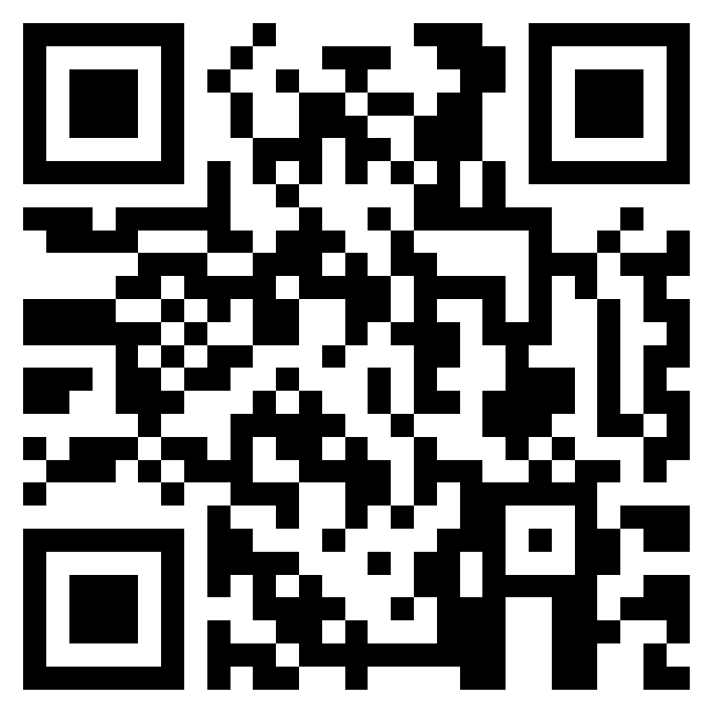
Teacher Survey
Notes:
Teacher, please scan the QR code or click the link below to complete a brief feedback survey.
https://forms.office.com/r/i9UqyyxzTT

Slide 12

Human Relations, Diversity & Equity

